Slide 1
Use of The DIF App
Questions or issues can be sent to David Schreurs at schreurd@uwm.edu

Slide 2
DIF Methods Used
Mantel-Haenszel
M-H searches for DIF through the construction of a 2 (subgroup 1/subgroup 2) x 2 (correct response/incorrect response) table for each proficiency level of student. Can only detect uniform DIF.
Logistic Regression
While less sensitive to the detection of uniform DIF, Logistic Regression is capable of detecting, and differentiating, between uniform and non-uniform DIF. This method models each of the subgroups independently and then searches for a significant main effect (indicating uniform DIF) as well as a significant interaction (indicating non-uniform DIF).
Lord's chi-squared (a.k.a Lord’s Wald test)
This test requires the construction of independent IRT models for each of the subgroups and then searches for a significant difference between the model parameters. This method detects uniform and non-uniform DIF but does not differentiate between them.
Purification
Each of the aforementioned methods is also conducted following purification. As all of these IRT methods require accurate scores or IRT models, purification iteratively removes items that were detected as showing DIF (and therefore were contaminating the test score or IRT model) and uses the new score/model to reconduct the DIF analysis. This is repeated until no further DIF is detected.

Slide 3
Table of Contents
Preparing Data
Using the App
Interpreting Exported Results

Slide 4
Data
Before this app can be used the raw data needs to be prepared. This app allows you to import data saved as an excel document (.xlsx).
The excel document should include at least
1 column for each question wishing to be compared between two tests
All cells besides the heading must be a 0 (incorrect responses) or a 1 (correct responses). No other values or blanks are allowed and will result in an error message.
1 column for “grouping” indicating which assessment the student took
All cells besides the heading must be a 0 or a 1. This means the tests have to be compared in independent pairs (e.g. Test 1:Test 2, Test 1: Test 3, Test 2: Test 3)
1 row for each student who complete data is available for

Slide 5
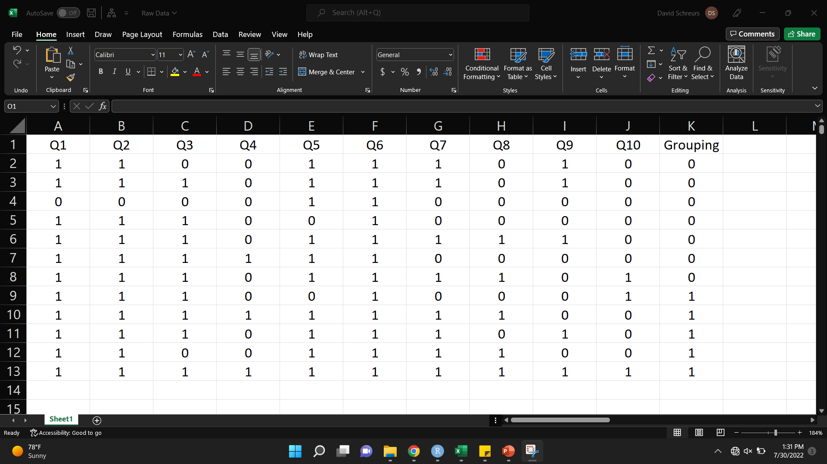
Example Data
Grouping (Which Test)
Questions
*Other columns can be present as long as they are selected to be omitted later on or contain the external score used for analysis
Student Data
0: Incorrect
1: Correct

Slide 6
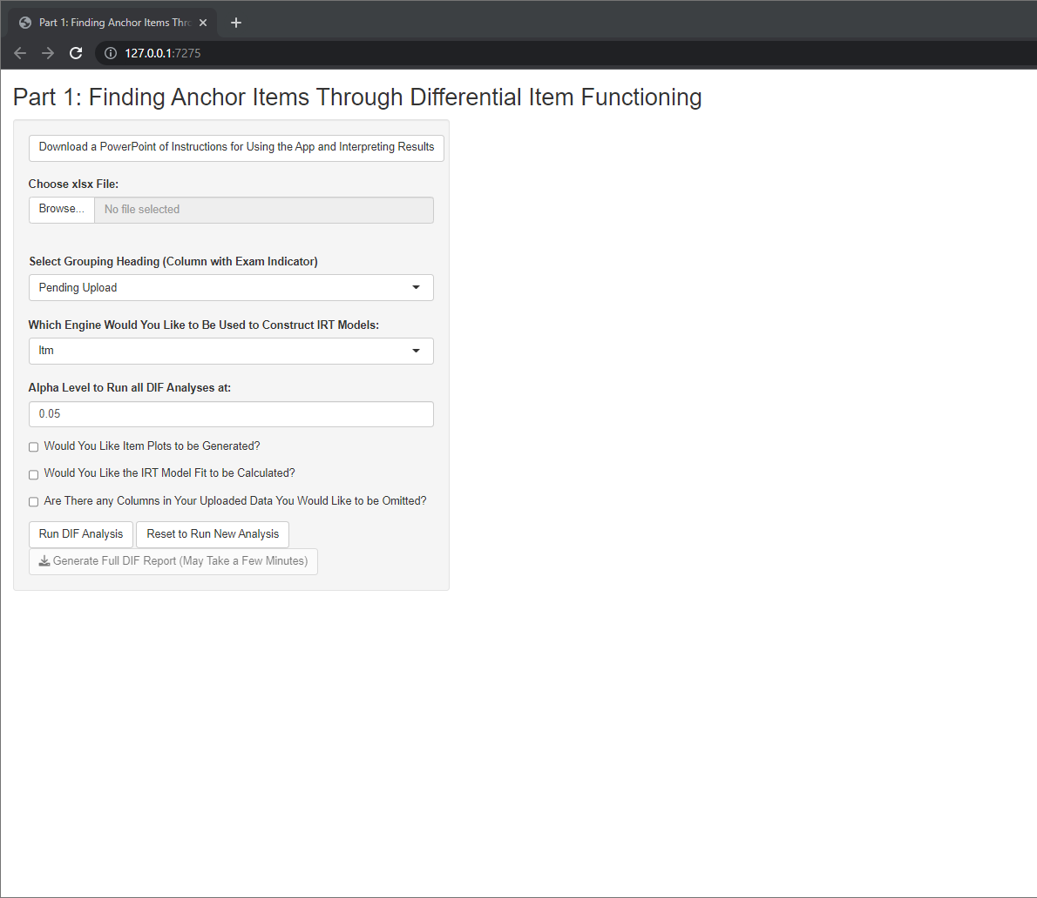
Using the App
Step 0: This button will allow you to download this PowerPoint document should you ever lose this copy or require instructions for future versions.

Slide 7
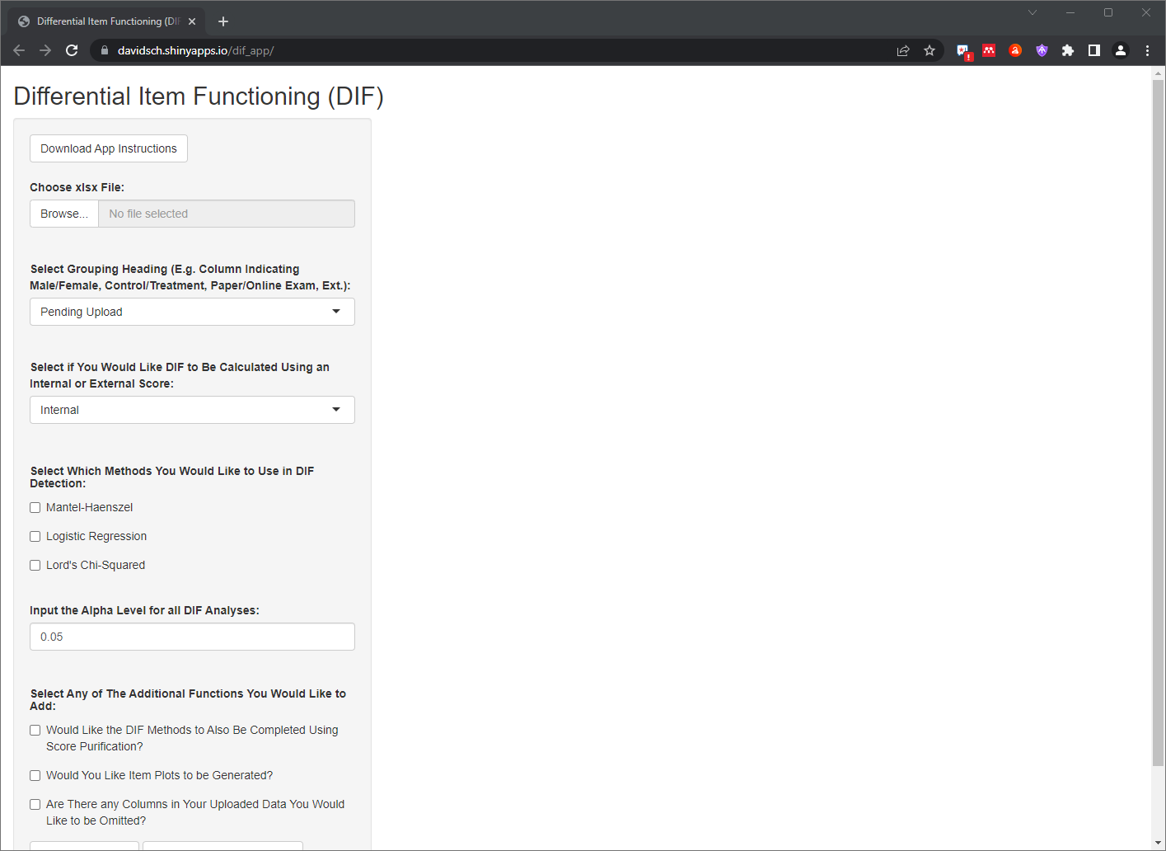
Using the App
Step 1: Click “Browse” which will prompt you to select the excel file you prepared during the previous slides

Slide 8
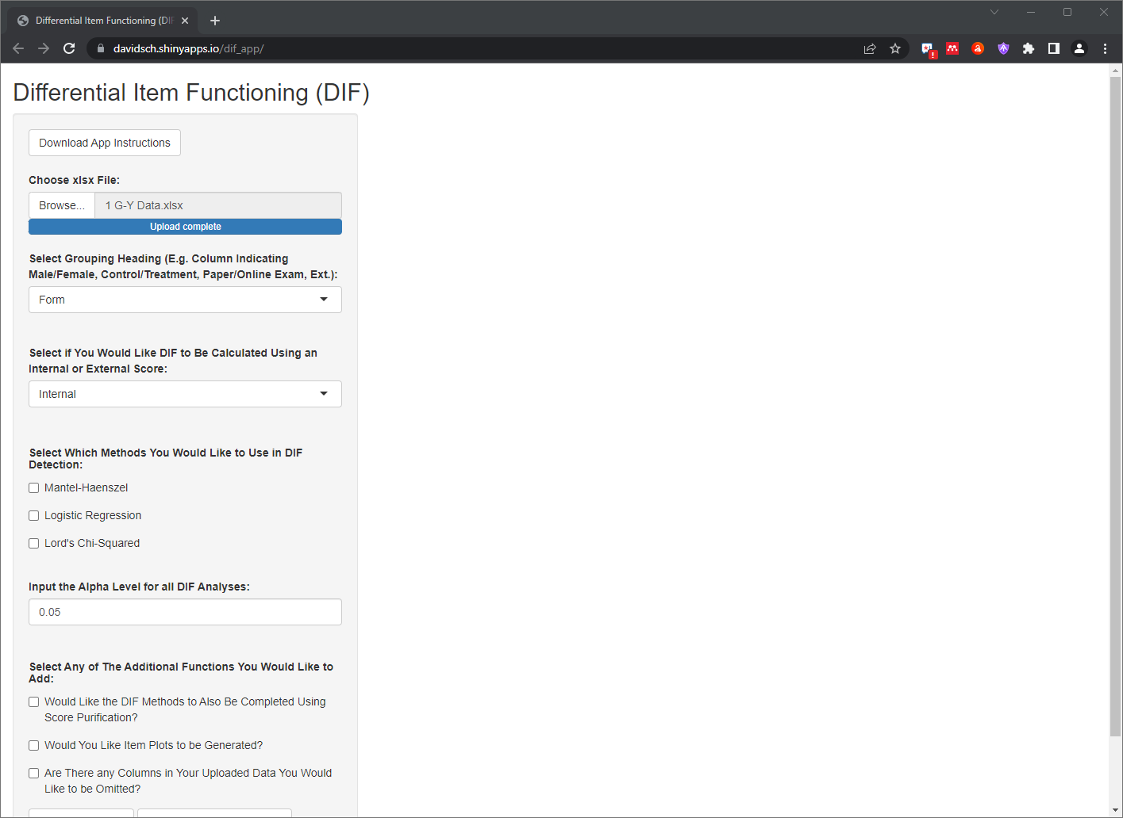
Using the App
Step 2: This dropdown menu will now be updated to provide the headings from the excel document which was uploaded. Select the heading corresponding to the column of data specifying the test the data was from. In this case, I named this column “Form”

Slide 9
Using the App
Step 3: This dropdown allows you to specify which type of score you would like to use for matching. Internal scores mean the test score will be calculated automatically based on the data. External scores would need to be listed in one of the columns of the dataset and could include things such as ACT, placement exam, ext.

Slide 10
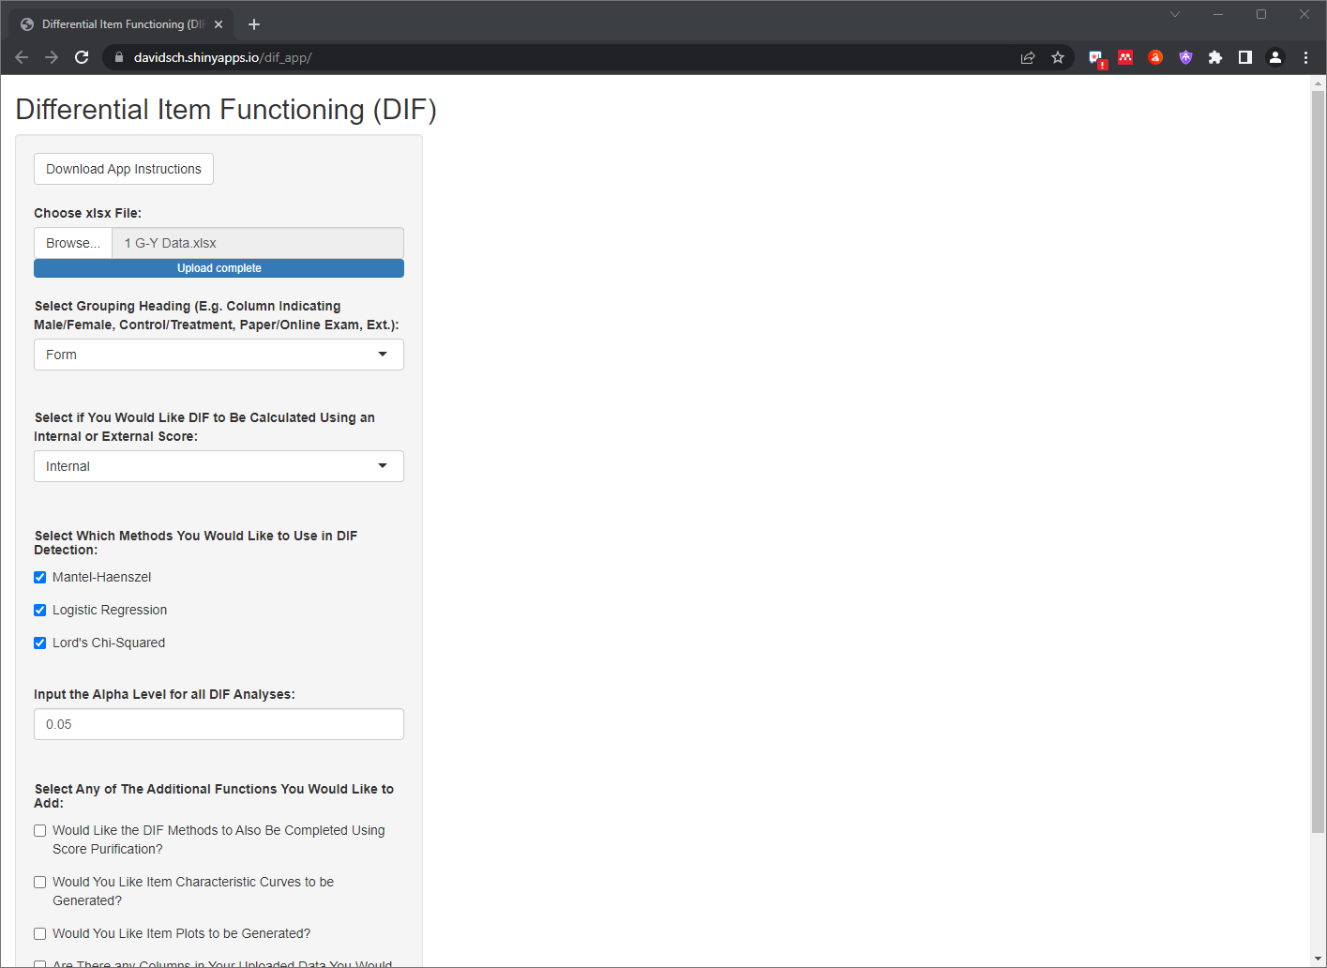
Using the App
Step 4: Here you can select all of the DIF methods which are available to be run based on the information you’ve inputted so far

Slide 11
Using the App
Step 5: Here you can input the alpha level you would like all analyses to be run at. This is set to 0.05 by default but with this many different analyses and with purification occurring a lower alpha will likely be more appropriate.

Slide 12
Using the App
Step 6: If internal scoring is used, here you can enable wether score purification will take place. This process iteratively removes the worst DIF item from score calculation until consistent results are generated.

Slide 13
Using the App
Step 7: If Lord’s Chi-Squared is selected, here you can create and export the ICCs

Slide 14
Using the App
Step 8: The next option should be checked if you would like item plots to be generated. These plots are a convenient method to visualize DIF from the perspective of CTT. However, selecting this option means the exporting of the data will take longer.

Slide 15
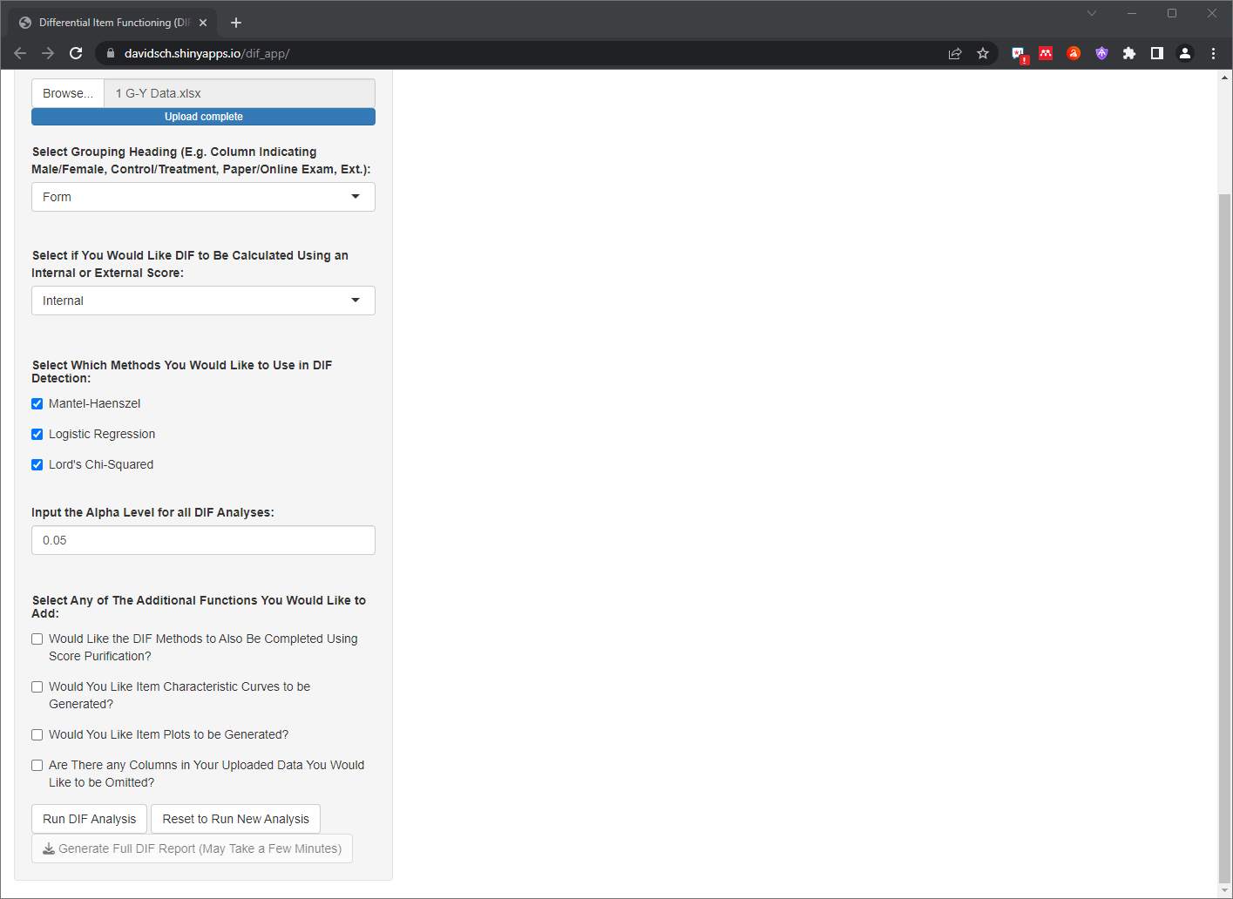
Using the App
Step 9: This final option should be selected if your dataset includes any columns besides the relevant question-level data and the grouping column used to specify the exam (e.g. student identifiers, student sex, undesired questions, ext).

Slide 16
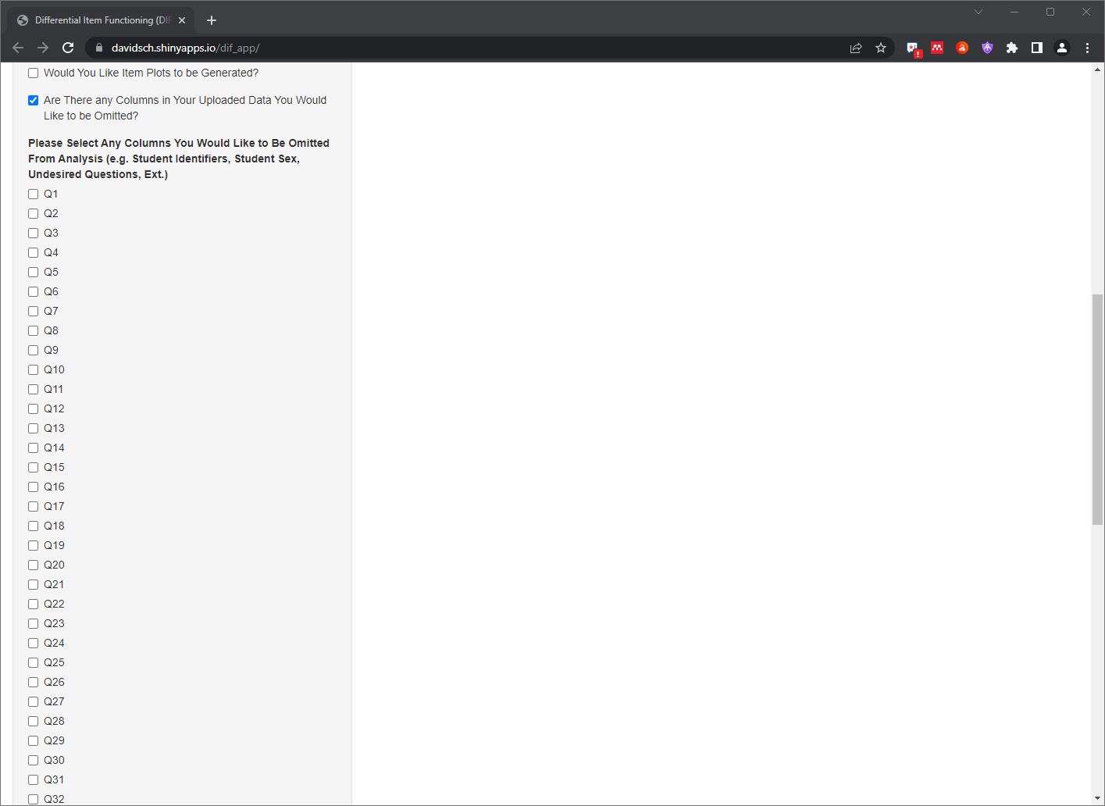
Using the App
Step 7B: If you indicated there are columns of data to be omitted, this new selection will pop-up with all of the column headings of your document. Select all columns that do not include the relevant data.
Side note: Your grouping column can be selected or left unselected

Slide 17
Using the App
Step 8: Click “Run DIF Analysis” when you have selected all relevant options.

Slide 18
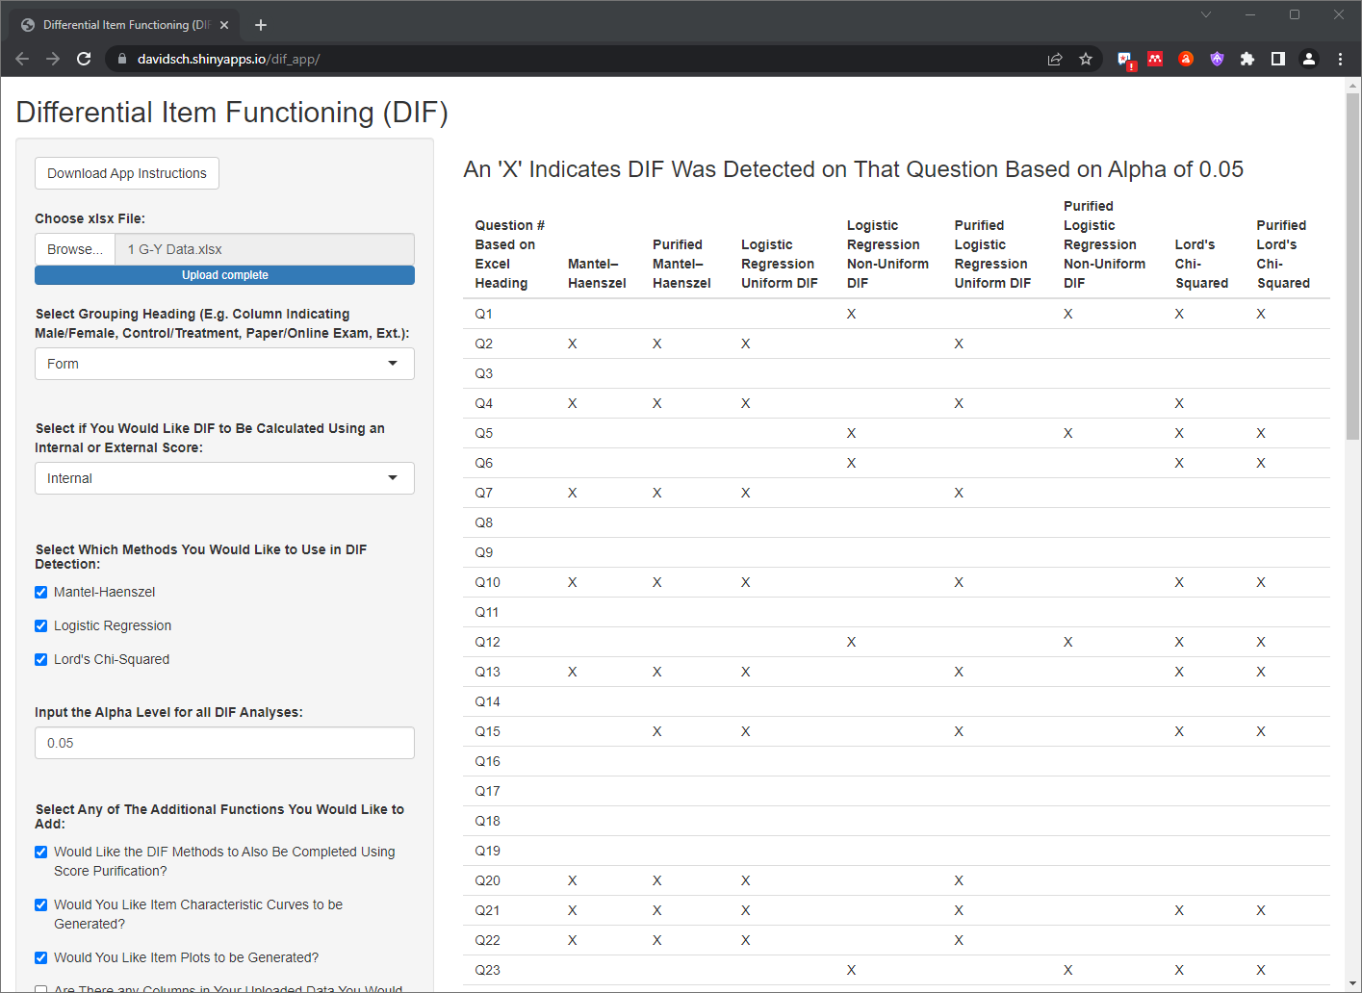
App Preliminary Results
The right of the page will show an “X” anywhere DIF was detected using the significance value provided

Slide 19
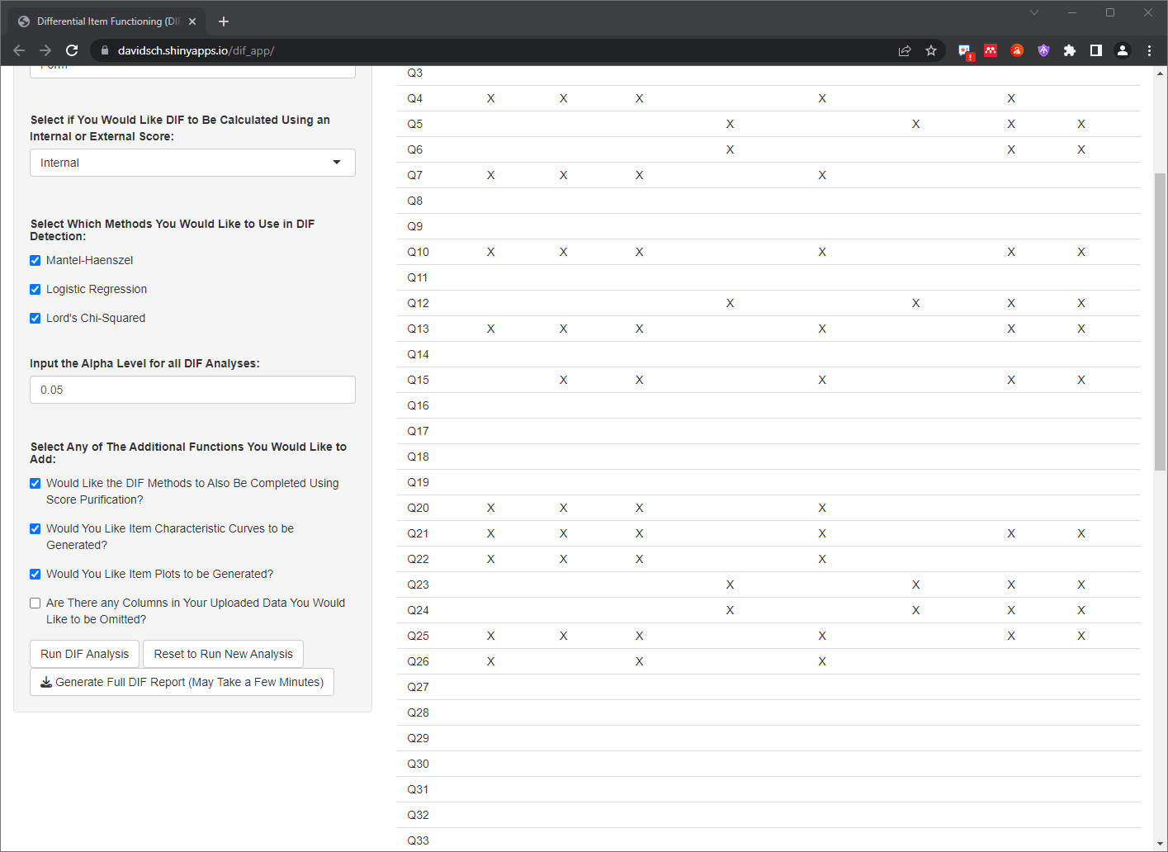
App Full Results
To get quantitative values, click “Generate Full DIF Report (May Take a Few Minutes)”. As indicated, this will take a few minutes depending on your previous checkbox selection. This will export the preview shown on the page, the quantitative values relative to each analysis, the IRT parameters from each model, item plots of the data (depending on selection), and the IRT model fits (depending on selection).

Slide 20
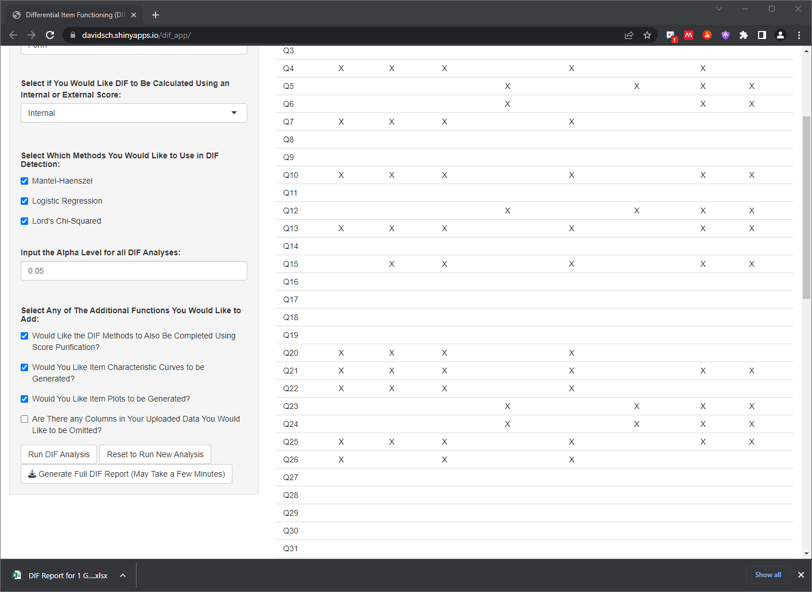
App Full Results
After the report is generated, a file will be downloaded. In chrome, this will appear on the bottom of the screen as well as in the computers “Downloads” folder. The file is named “DIF Report for…” prior to the name of the file selected for analysis. Since my data file was named “1 G-Y Data.xlsx”, my downloaded file is named “DIF Report for 1 G-Y Data.xlsx”

Slide 21
App Full Results
To run a different analysis, you can either exit and relaunch the app or press the “Reset to Run New Analysis” button.

Slide 22
Interpreting Exported Results
The downloaded document should be an excel document which contains several tabs of data.
File Summary
Results Preview
Numeric Results
Item Plots (*If Selected)
ICCs (*If Selected)

Slide 23
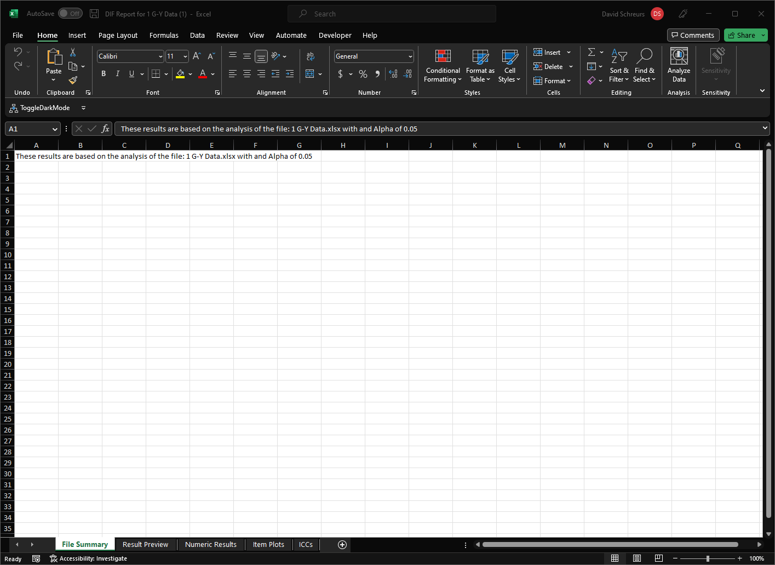
1. File Summary
A reminder of what data and what alpha value this analysis corresponds to.

Slide 24
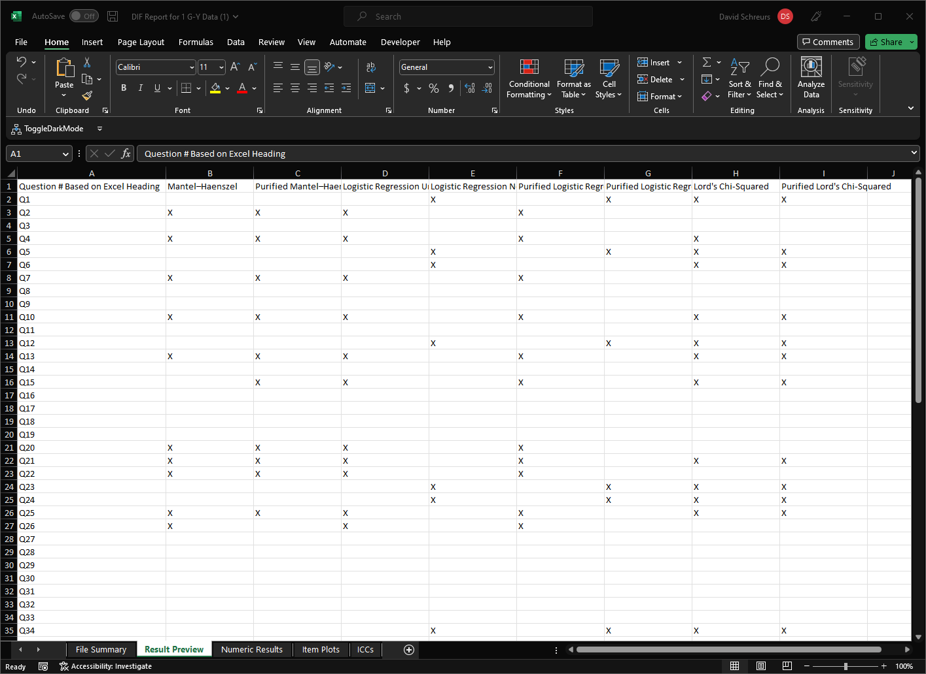
2. Results Preview
An export of the results preview shown within the app. Once again, an “X” indicates that DIF was detected for that question, through that method, at the specified alpha level.

Slide 25
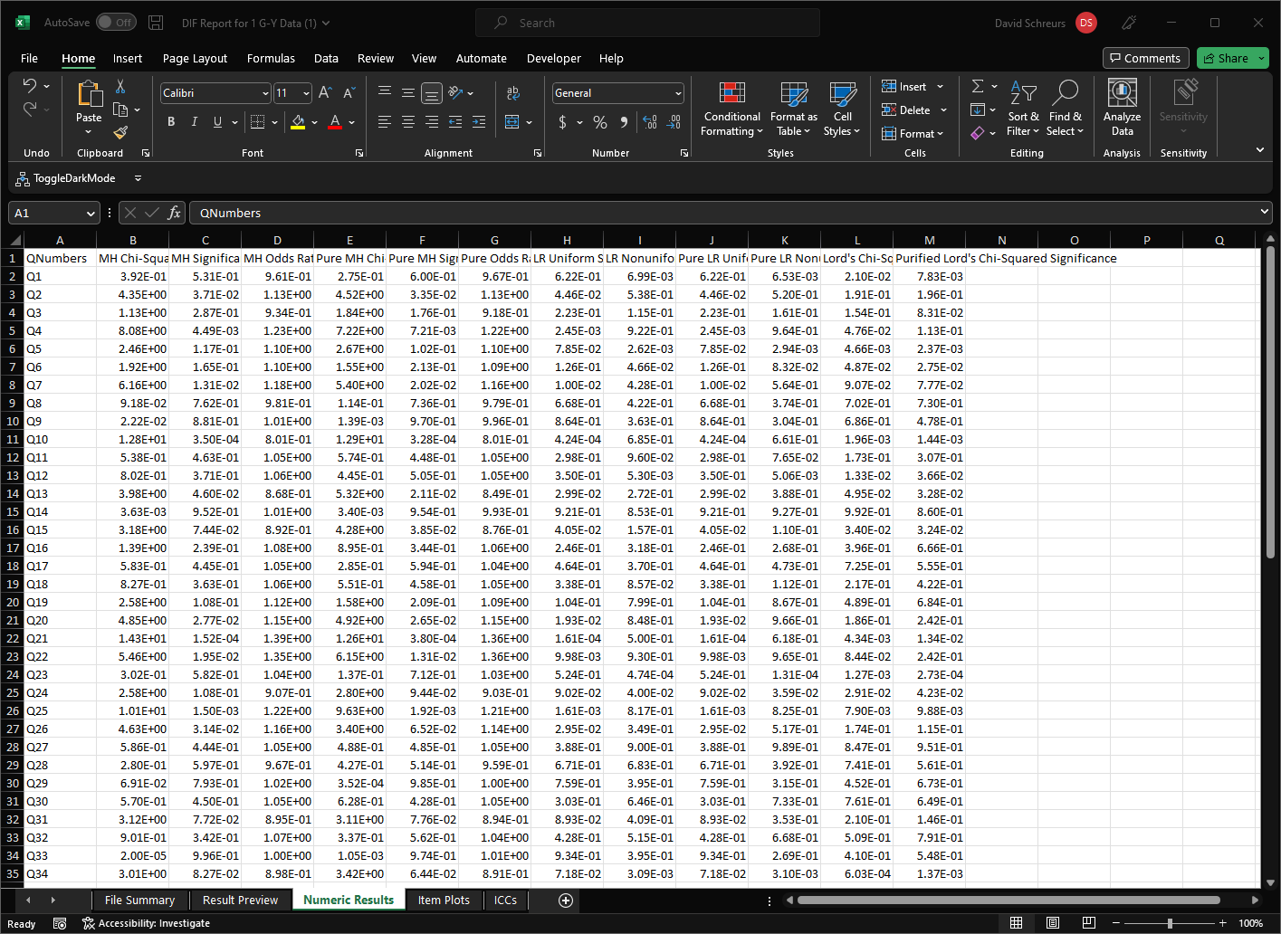
3. Numeric Results
Quantitative values important for each of the methods used. Each of these are described on the next slide in more detail.

Slide 26
3. Numeric Results
MH Chi-Squared
When using the Mantel-Haenszel (MH) method, this was the chi-squared value calculated which was used to determine DIF significance
MH Significance
When using the Mantel-Haenszel method, this was the significance value which was compared against the specified alpha level to determine DIF significance
MH Odds Ratio
When using the Mantel-Haenszel method, this odds ratio shows the effect size and favor of the DIF. Values great than “1” are interpreted as the students taking exam “1” performed __ times better than students taking exam “0”. Values less than “1” are interpreted as the students taking exam “0” performed 1/__ times better than students taking exam “1”.
Pure MH Chi-Squared
When using the Mantel-Haenszel (MH) method and conducting purification, this was the chi-squared value calculated which was used to determine DIF significance
Pure MH Significance
When using the Mantel-Haenszel method and conducting purification, this was the significance value which was compared against the specified alpha level to determine DIF significance
Pure Odds Ratio
When using the Mantel-Haenszel method and conducting purification, this odds ratio shows the effect size and favor of the DIF. Values great than “1” are interpreted as the students taking exam “1” performed __ times better than students taking exam “0”. Values less than “1” are interpreted as the students taking exam “0” performed 1/__ times better than students taking exam “1”.

Slide 27
3. Numeric Results
LR Uniform Significance
When using the Logistic Regression method and searching for uniform DIF, this was the significance value which was compared against the specified alpha level to determine DIF significance
LR Nonuniform Significance
When using the Logistic Regression method and searching for non-uniform DIF, this was the significance value which was compared against the specified alpha level to determine DIF significance
Pure LR Uniform Significance
When using the Logistic Regression method, searching for uniform DIF, and conducting purification, this was the significance value which was compared against the specified alpha level to determine DIF significance
Pure LR Nonuniform Significance
When using the Logistic Regression method, searching for non-uniform DIF, and conducting purification, this was the significance value which was compared against the specified alpha level to determine DIF significance
Lord's Chi-Squared Significance
When using the Lord's chi-squared method, this was the significance value which was compared against the specified alpha level to determine DIF significance.
Purified Lord's Chi-Squared Significance
When using the Lord's chi-squared method and conducting purification, this was the significance value which was compared against the specified alpha level to determine DIF significance.

Slide 28
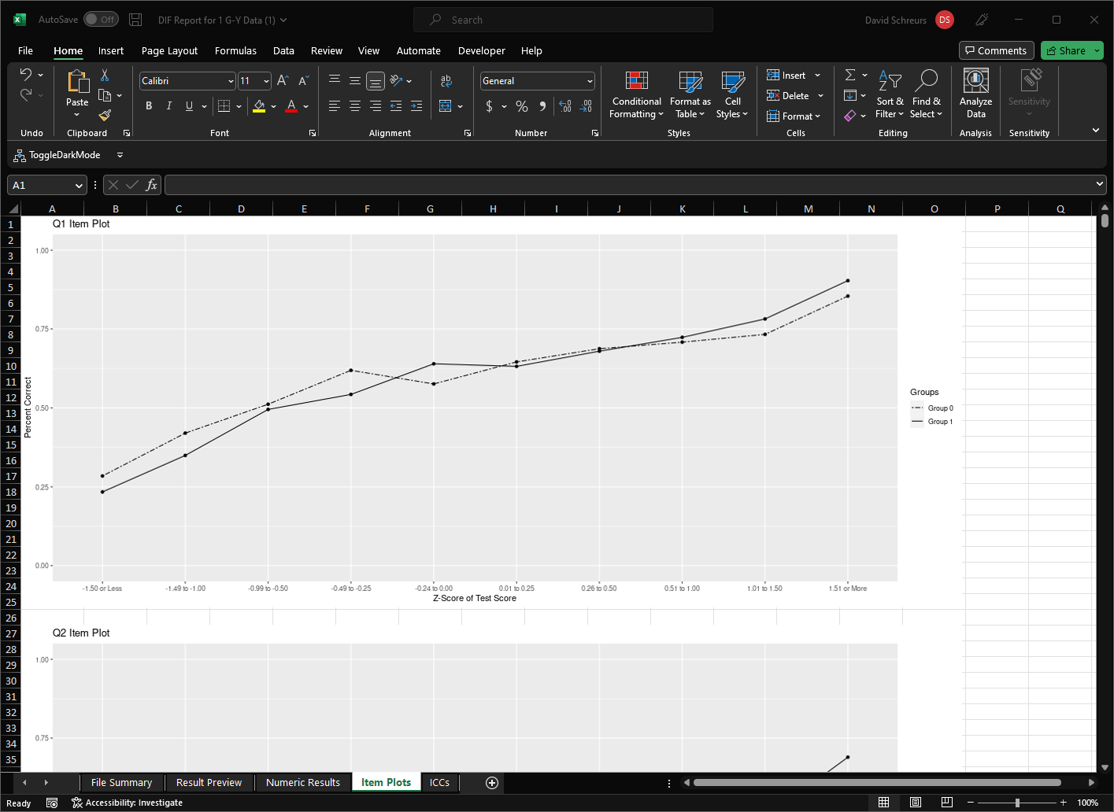
4. Item Plots (*If Selected)
Classical test theory method for visualizing DIF. The x-axis has binned z-scores of students test scores (or external score if selected) and the y has the percent of students within that bin who answered the question correctly. Crossing of lines suggests nonuniform DIF as seen in Q1.

Slide 29
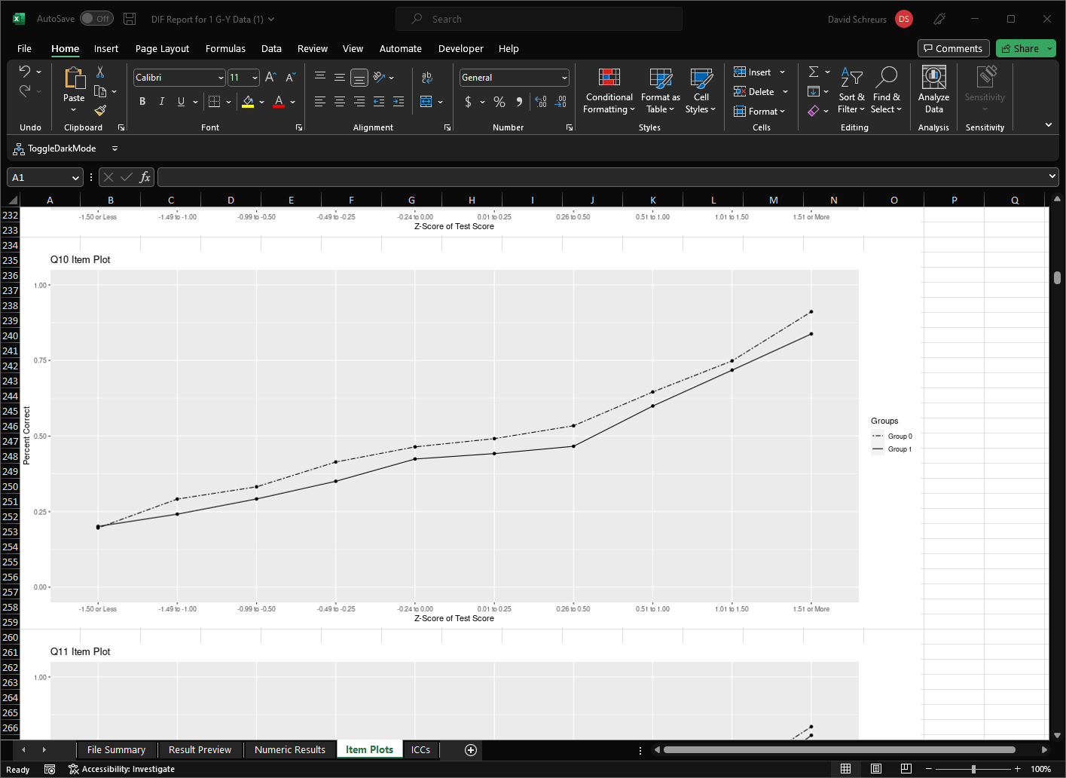
4. Item Plots (*If Selected)
Misalignment of lines suggests uniform DIF (similar slopes but shifted up), favoring students who were in group 0 (dotted line above solid line), shown in Q10.

Slide 30
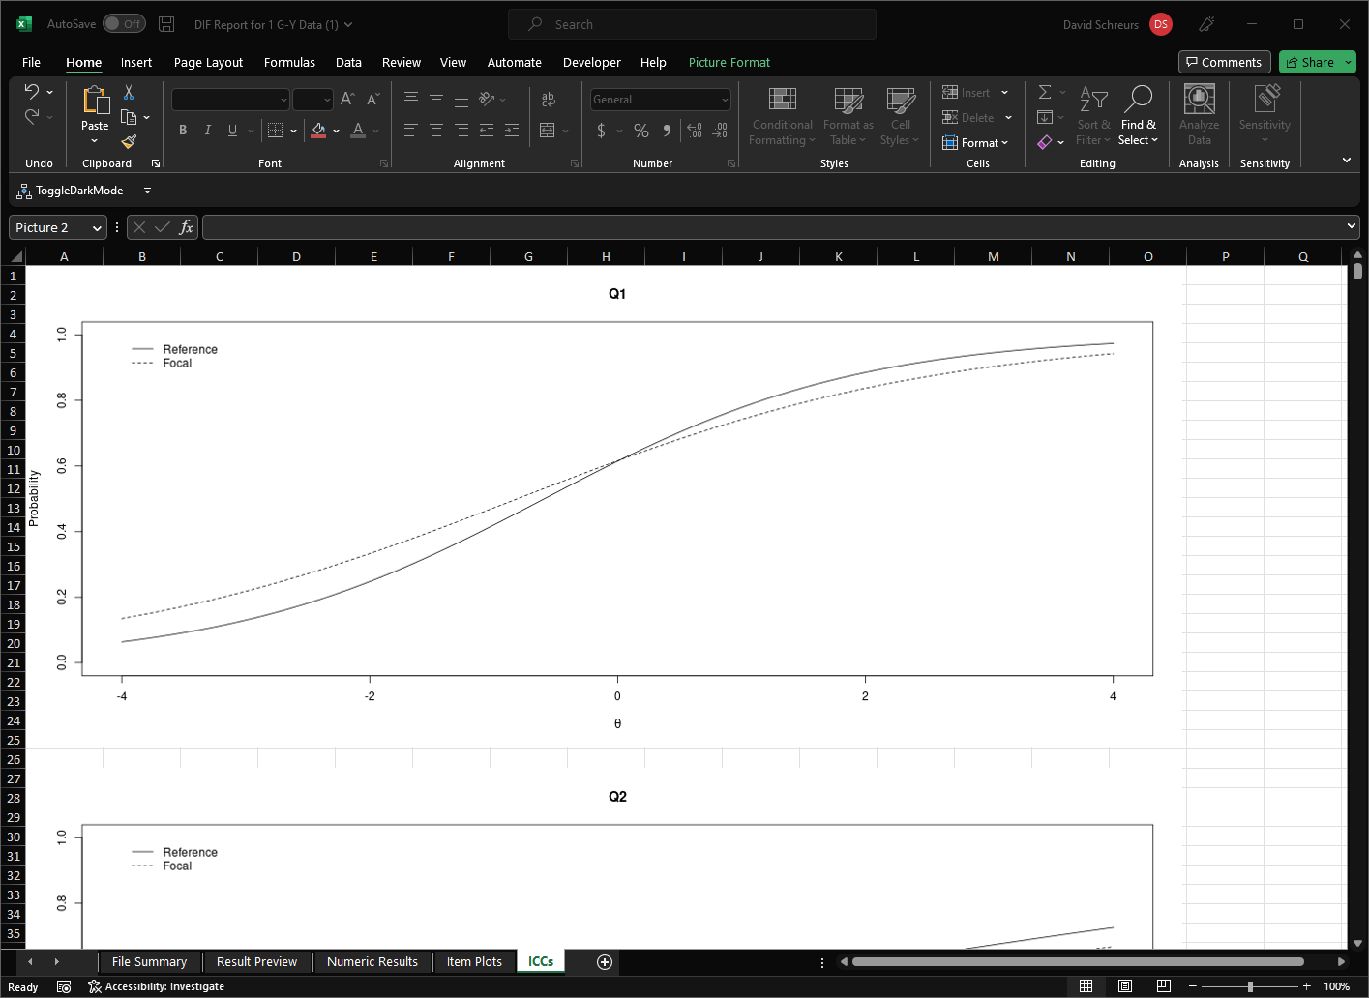
5. ICCs (*If Selected)
The IRT equivalent to CTT item plots. The x-axis is now student ability as a z-score and the y is the probability of a student with that ability answering this question correctly. Once again, the crossing in Q1 suggest nonuniform DIF.

Slide 31
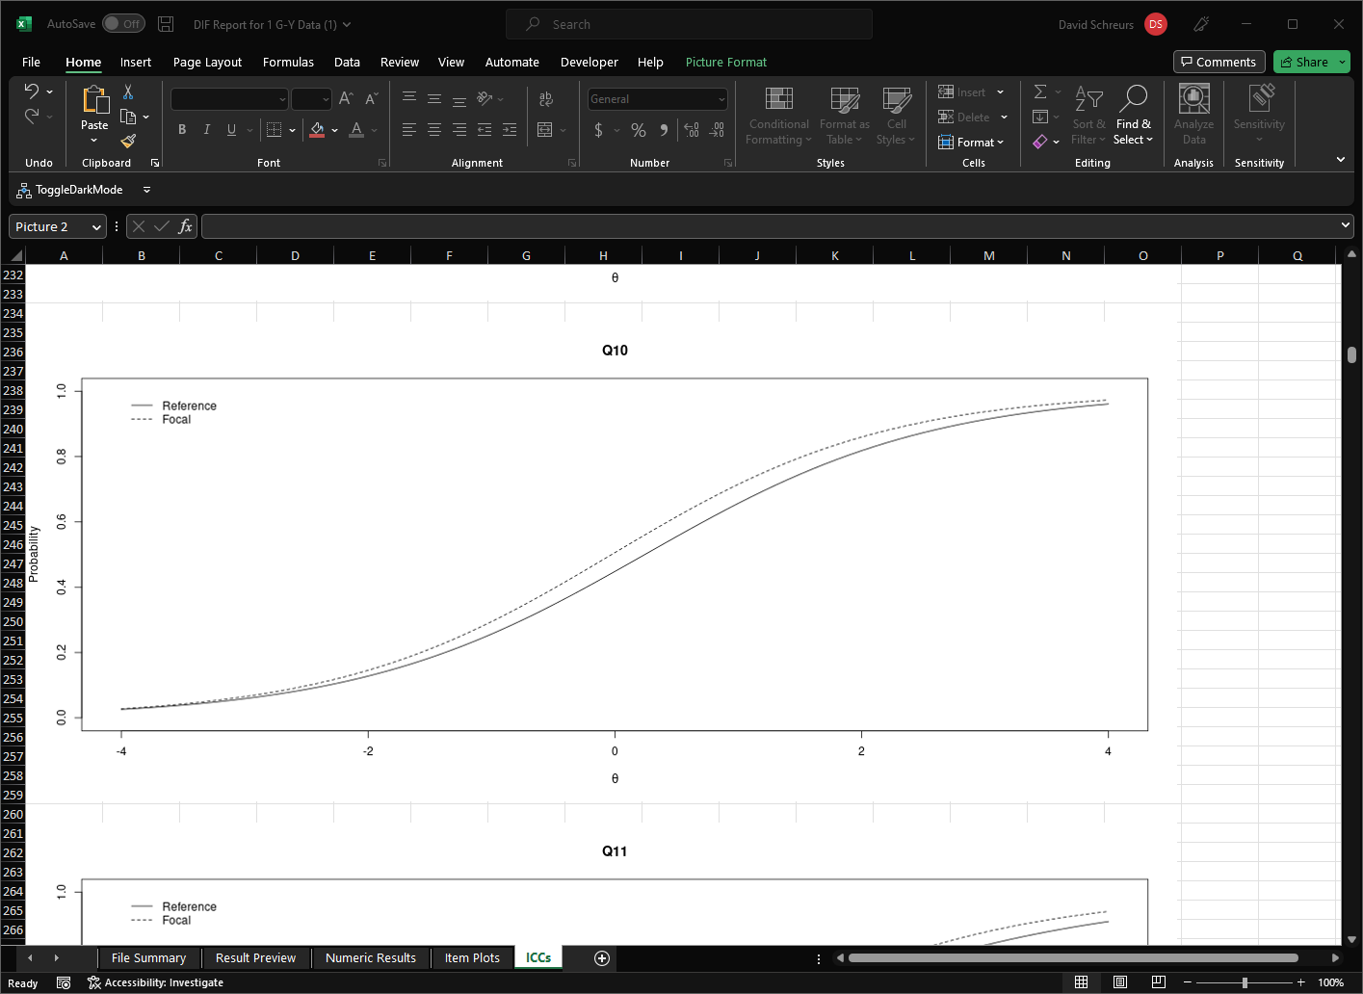
5. ICCs (*If Selected)
Once again, the vertical shift in Q10 suggests uniform DIF.

